Slide 1

Quiz Time
By: Jash Patel, Matthew Wu, Deo Khisa, Sai Nair, Sanjay Pillai

Slide 2
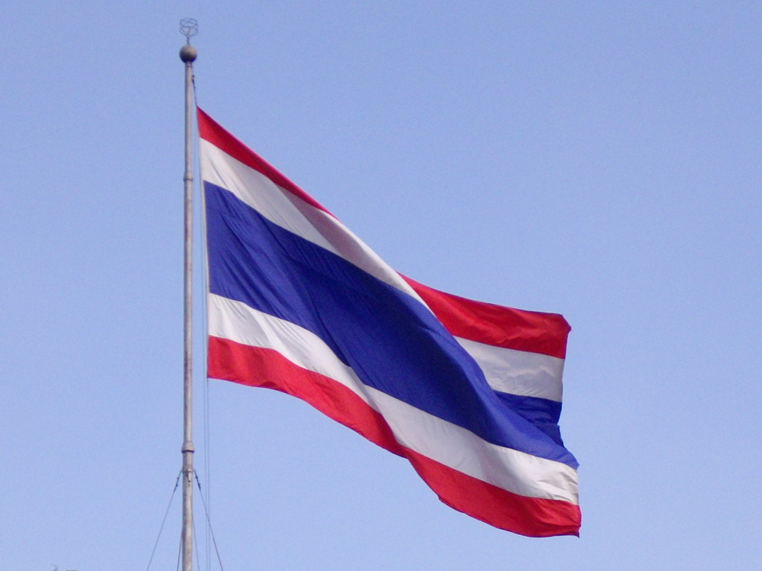
What is the third line of the Thai National Anthem
The land of Thailand belongs to all the Thais
Their sovereign has always long endured
No tyrant can their freedoms take away
The Thais will give up every drop of blood

Slide 3
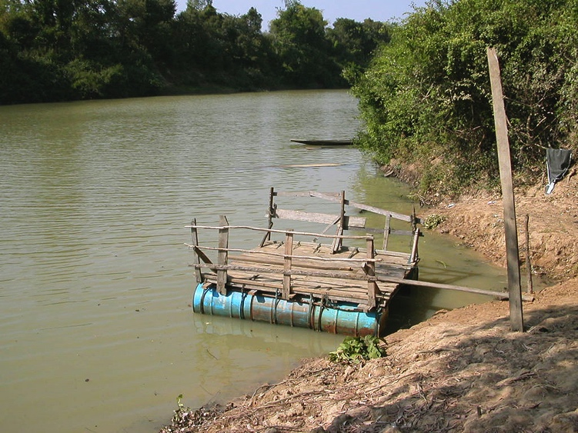
How long is the Chi River?
1049mi
651km
1049’
651mi

Slide 4
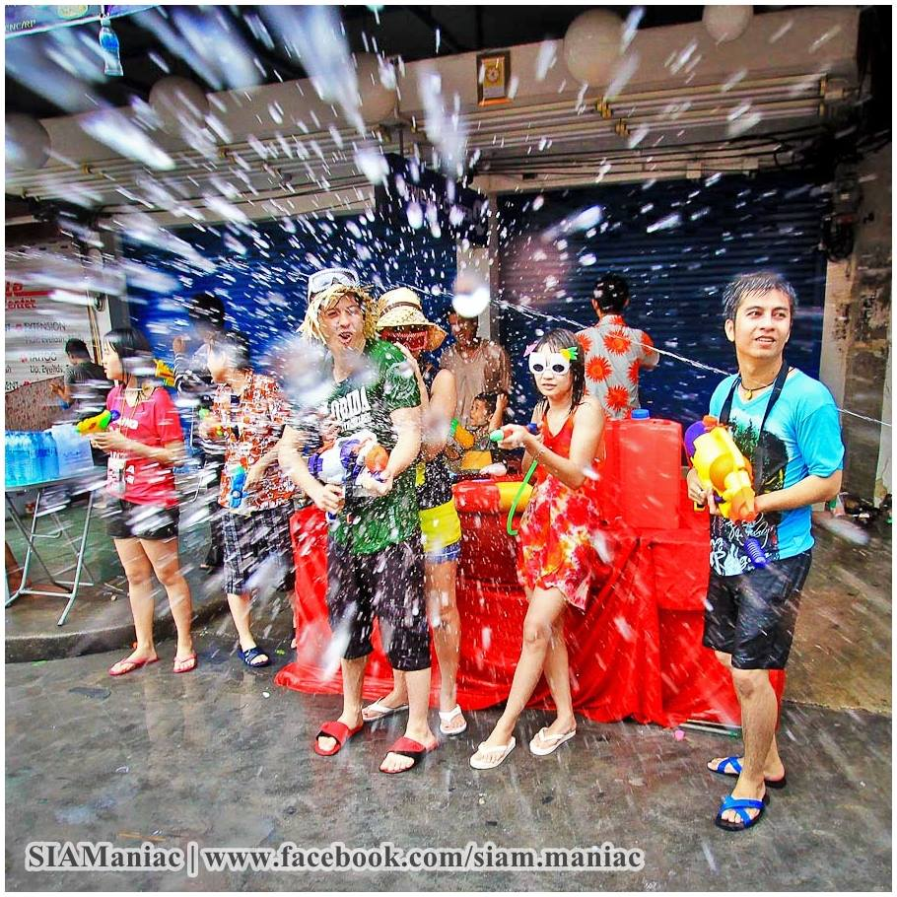
When is Songkran celebrated?
15-18 April
13-15 August
15-18 August
13-15 April

Slide 5
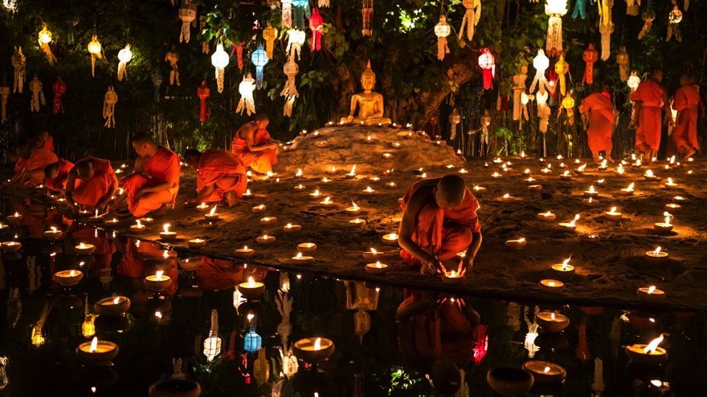
When is Krathong celebrated?
31st December
1st December
Full moon is the 12th Thai month
Full moon 10th Thai month

Slide 6
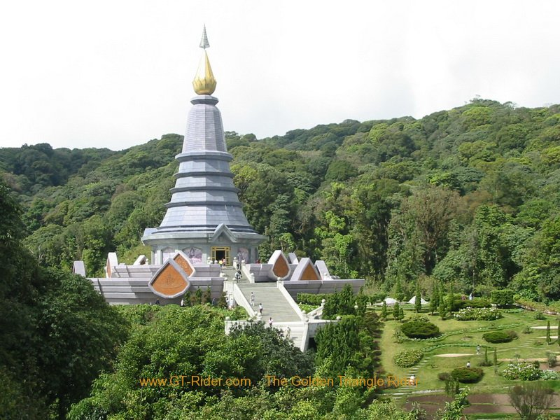
How tall is Doi Inthanon?
8415km
8415’
2565’
8415mi

Slide 7
What is the largest city in Thailand?
Songkhla
Doi Inthanon
Bangkok
Bang Choi

Slide 8
What is the capital city in Thailand?
Songkhla
Doi Inthanon
Bangkok
Bok Choi

Slide 9
How many hours ahead of GMT is Thailand?
1 hour
15 hours
9 hours
7hours

Slide 10
What is the population of Thailand since 2013?
67.01
67.01 million
67.01 billion
67.1 million

Slide 11
What country is most near Thailand?
China
America
Sri Lanka
Laos

